Slide 1
WASH Systems for health: establishing approaches to strengthen WASH systems in six countries in Africa and Asia
Tuesday 24th October 2023
UNC Water and Health

Slide 2
Agenda
Introduction by Lisa Rudge, FCDO
WASH Systems Strengthening: definitions and frameworks by Vida Duti, IRC
Overview of the WASH Systems for Health (WS4H) programme by Lisa Rudge, FCDO
Monitoring and Evaluating WASH Systems Strengthening by Angela Huston, IRC
Research and learning agenda: interim evidence and next steps by Lauren D’Mello-Guyett, LSHTM
Break-out groups by building blocks by all
Next steps and close by Lisa Rudge, FCDO

Slide 3
WASH Systems strengthening: definitions and frameworks
Vida Duti, IRC

Slide 4
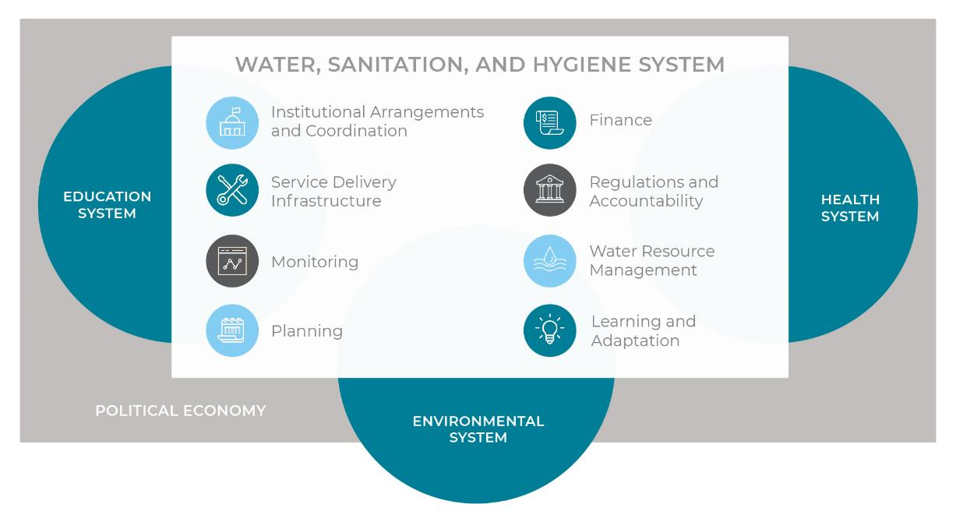
The WASH system is part of health systems, environmental systems, education, and others
Notes:
Mental models

Slide 5
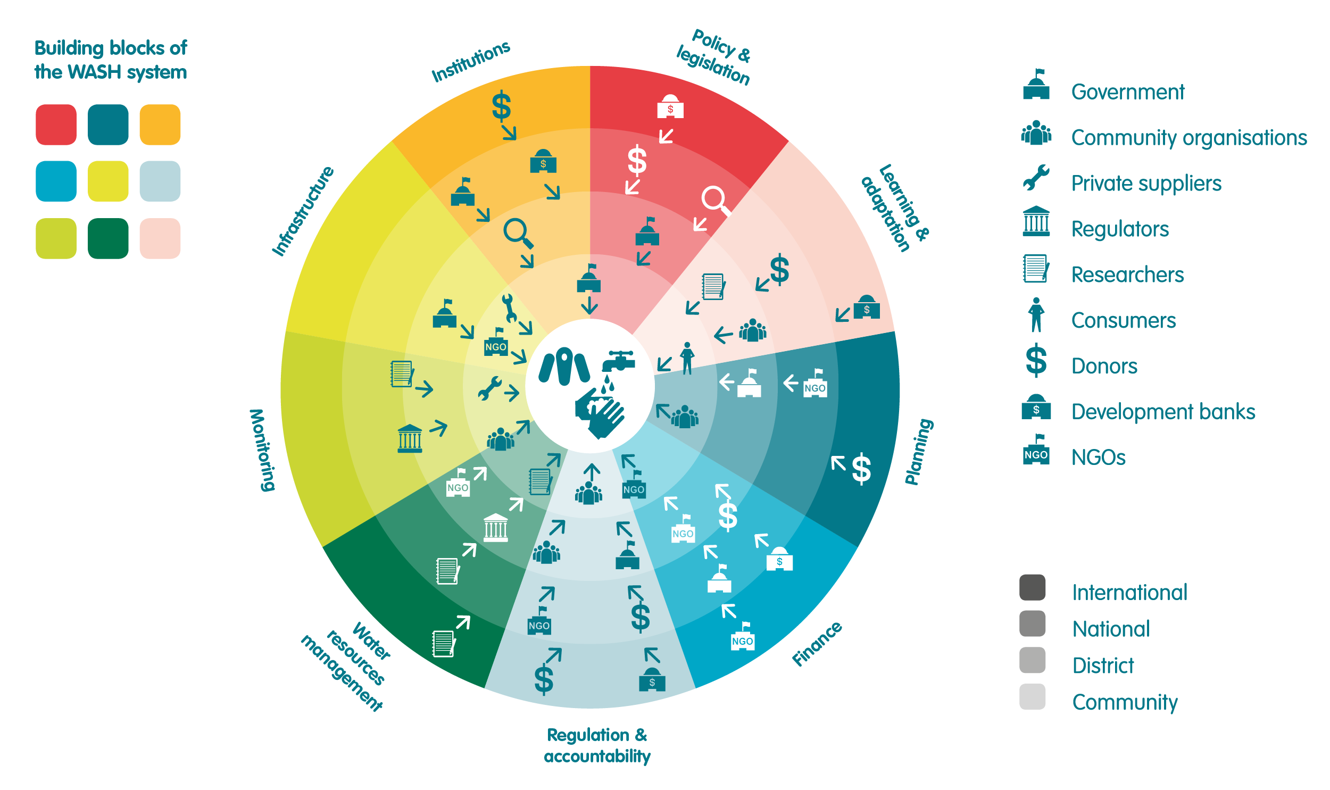
There are many ways of viewing WASH systems for health
Notes:
Mental models

Slide 6
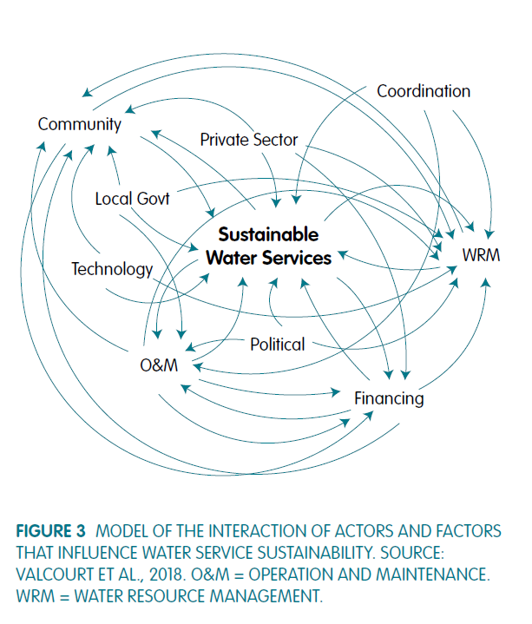
Most frameworks for WASH systems consider:
actors (people and institutions)
factors or components, sub-systems
interactions and dynamics
multiple levels of engagement and/or flexible boundaries e.g. district, national, international
Notes:
Mental models

Slide 7
We understand systems in order to drive change
What we do
Intermediate outcome
Outcome
Why
SYSTEMS STRENGTHENING
STRONG WASH
SYSTEM
WASH SERVICES
HEALTH, LIVES, EQUITY
Political economy and context

Slide 8
Preconditions for successful WASH systems strengthening
Government leadership
Shared vision and monitoring of progress
Culture of shared results– contribution through partnerships and complementarity of interventions
An integrated approach that identifies and leverages connections between sectors

Slide 9
WASH Systems for Health- Programme Overview
- Lisa Rudge, FCDO
UNC Water and Health, Chapel Hill, October 2023

Slide 10





Water, Sanitation and Hygiene in the FCDO
2011-2020: 120 million people with access to WASH with UK support
Sustainability of WASH services
WASH Systems Strengthening Approach
May 2016
ICAI WASH Results Review
March 2020
COVID 19
April 2022
ICAI Information Note on WASH
2019 WASH Sustainability Assessment

Slide 11
WASH Systems for Health - £18.5m - March 2023 - March 2028
Aims
To support governments in up to six developing countries in Sub-Saharan Africa and South Asia to strengthen the systems needed to establish reliable, resilient and inclusive WASH services
Contribute to global learning on approaches to strengthening WASH Systems
Provide broader WASH Systems advice and support to governments and to FCDO Posts
WASH Systems Strengthening Implementing Partners
Call for Proposals Open until 17th November 2023
Strengthening WASH Systems in 6 countries: Bangladesh, Malawi, Nepal, Nigeria, Sierra Leone, Tanzania
Activities undertaken with host government and development partners, set by context and demand
WASH Systems Facility
IRC WASH
University of Leeds
London School of Hygiene and Tropical Medicine
WASH Systems Assessments in 16 countries (9 in-depth)
Technical Assistance and Expert Call-down Facility (available to 16 countries)
Monitoring, Evaluation and Learning
Business case approved
February 2023
WASH Systems Facility March 2023
Call for Proposals launched 17 October 2023
Implementation January 2024 – December 2027

Slide 12
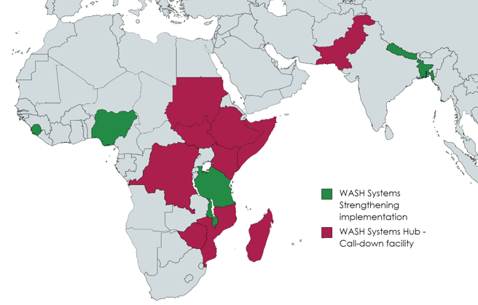
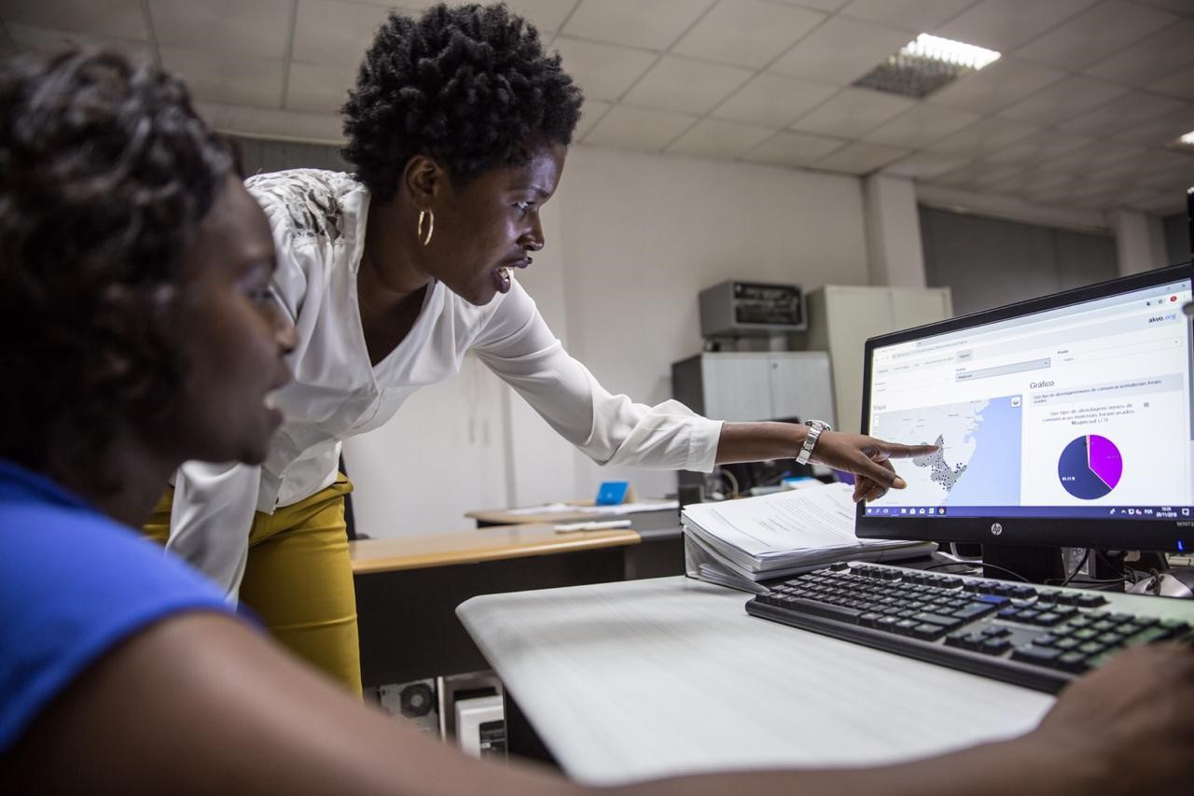
WASH Systems Assessments
Identifying WASH systems strengthening opportunities:
Establish demand for systems approach
Leadership and appetite for reform
Leverage of other initiatives and investments
Complementarity with government and development partners
Coherence with FCDO engagement
WASH Systems Strengthening implementation
Bangladesh
Malawi
Nepal
Nigeria
Sierra Leone
Tanzania
WASH Systems Hub operating countries
Democratic Republic of Congo
Ethiopia
Kenya
Madagascar
Mozambique
Pakistan
Somalia
Sudan
South Sudan
Zimbabwe
Information management – PRONASAR, Mozambique

Slide 13
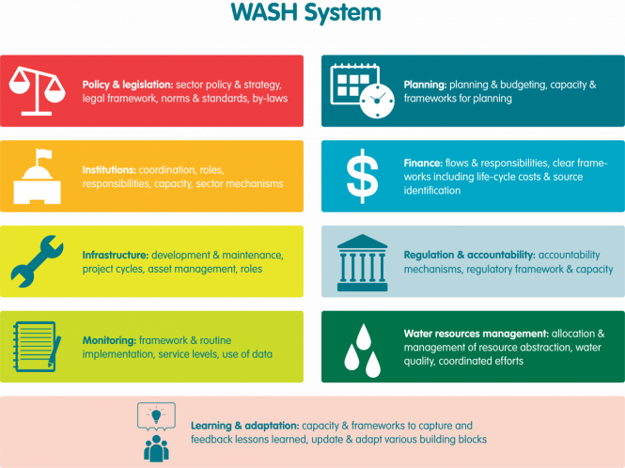
Examples of WASH systems interventions
Health
System
WASH System
Education System
Professionalisation of rural water supplies:
Regulation
Private sector models
Monitoring and information management system
WASH in health facilities:
Multi-sector planning and coordination
Monitoring and information management
Financial flows: investment and maintenance and operation
Strengthening sub-national capacities:
Collect, analyse and use data for decision-making
Procurement processes
Support to liquid and solid waste management:
Regulation
Management models
Private sector participation
Support to implementing regulatory frameworks :
Technical assistance
Implementation at sub-national level

Slide 14
Summary Theory of Change
Activities
Major Outputs
Intermediary Outcomes
Outcomes
Impact
Establish need and demand
Work ‘politically’, understanding behavioural drivers of change
Develop programme priorities and actions with host govts and other stakeholders, examples
Agree workplan and SMART results framework
Implementation of workplans, review progress, refine approach
Document and disseminate results to inform global WASH sector through SWA and other fora.
WASH system strengthened in key areas to address identified bottlenecks covering institutional arrangements; capacity; financing; asset management and regulatory oversight
WASH systems in six countries strengthened, addressing systemic bottlenecks to improve performance at national and sub-national level
Increased access to and use of inclusive, reliable, resilient WASH services in up to six target countries
Development partners shift from support to direct delivery of WASH facilities to supporting WASH services
Progressive reduction in the number of preventable deaths of poor mothers, children and infants due to WASH related disease
Lessons learnt and good practice shared to inform Global WASH sector through variety of networks and channels
Global WASH systems hub established to respond to demand from governments in ODA-eligible countries and Posts for advice and support on WASH systems strengthening
Monitoring, Evaluation, Accountability and Learning
Attribution: Implementing Partners and WASH Systems Facility
Contribution: Implementing Partners
Contribution
Contribution
Inputs
Specialist expertise: FCDO Internal, WASH NGOs, Private Sector, UN/MLDBs, Research and Learning organisations, Utilities Financial resources: (up to £ 18.5m over 5 years; est. 30 - 50% ICF) FCDO Network: Embassies and British High Commissions WASH partnerships: UK WASH Forum UK Water; Sanitation and Water for All (SWA) and others

Slide 15

Monitoring and evaluation approach for WASH Systems Strengthening
– Angela Huston, IRC
24 October 2023
UNC Water and Health Conference

Slide 16

Presentation index
Theory of Change for the WASH Systems for Health Programme
A results framework for the WASH Systems for Health Programme
Example Indicators
Questions and discussion

Slide 17

Overall approach for the WASH Systems for Health Programme
The programme has a theory of change, supported by a results framework
  The global framework is supported by contextualised country-level theories of change with specific outputs and outcomes
  Attention is given to context: the political economy and the underlying assumptions, and essential conditions, for driving change

Slide 18

Summary Theory of Change
Activities
Major Outputs
Intermediary Outcomes
Outcomes
Impact
Establish need and demand
Work ‘politically’, understanding behavioural drivers of change
Develop programme priorities and actions with host govts and other stakeholders, examples
Agree workplan and SMART results framework
Implementation of workplans, review progress, refine approach
Document and disseminate results to inform global WASH sector through SWA and other fora.
WASH system strengthened in key areas to address identified bottlenecks covering institutional arrangements; capacity; financing; asset management and regulatory oversight
WASH systems in six countries strengthened, addressing systemic bottlenecks to improve performance at national and sub-national level
Increased access to and use of inclusive, reliable, resilient WASH services in up to six target countries
Development partners shift from support to direct delivery of WASH facilities to supporting WASH services
Progressive reduction in the number of preventable deaths of poor mothers, children and infants due to WASH related disease
Lessons learnt and good practice shared to inform Global WASH sector through variety of networks and channels
Global WASH systems hub established to respond to demand from governments in ODA-eligible countries and Posts for advice and support on WASH systems strengthening
Monitoring, Evaluation, Accountability and Learning
Attribution: Implementing Partners and WASH Systems Facility
Contribution: Implementing Partners
Contribution
Contribution
Inputs
Specialist expertise: FCDO Internal, WASH NGOs, Private Sector, UN/MLDBs, Research and Learning organisations, Utilities Financial resources: (up to £ 18.5m over 5 years; est. 30 - 50% ICF) FCDO Network: Embassies and British High Commissions WASH partnerships: UK WASH Forum UK Water; Sanitation and Water for All (SWA) and others

Slide 19

Summary Theory of Change
Activities
Major Outputs
Intermediary Outcomes
Outcomes
Impact
PROGRAMME ACTIVITIES
WASH SYSTEM BOTTLENECKS ADDRESSED
STRONG WASH SYSTEMS
WASH SERVICES
HEALTH, LIVES, EQUITY
Activity monitoring
Attribution
Contribution
Contribution
Contribution
Political economy, context
Inputs
PROGRAMME RESOURCES
+ leveraged or complementary resources
Resource tracking and value for money indicators

Slide 20

The results framework…
Informs adaptive management and provides relevant country-level insights
Provides enough consistency to enable multi-country analysis and aggregation for research and learning
Draws on and adds value to existing monitoring systems such as government data, GLAAS/JMP, and partners’ existing systems
Regards programme contribution to larger change as important
Contributes to global community of practice seeking better ways to measure WASH systems change

Slide 21

Spheres of control / influence / interest
Sphere of interest
Sphere of influence
Sphere of control
Inputs
Activities
Major Outputs
Intermediary Outcomes
Outcomes
Impact
Programme actors:
Implementers
Contractors/subcontractors
Donor/funder
Boundary partners :
Government
Private sector
CSOs/NGOs
Other financiers/sector partners
End users :
Communities
Households
Women/girls
Marginalised groups
Citizens

Slide 22

Indicator types and data sources
Activities
Major Outputs
Intermediary Outcomes
Outcomes
Impact
PROGRAMME ACTIVITIES
WASH SYSTEM BOTTLENECKS ADDRESSED
STRONG WASH SYSTEMS
WASH SERVICES
HEALTH, LIVES, EQUITY
Political economy, context
Programme output indicators
Progress toward strengthening identified systemic bottlenecks
Successful implementation of programme activities
Index indicators and proxies
Index indicators and KPIs: strong systems building blocks and dynamics (w/GESI)
Service levels
National, subnational service levels disaggregated
Extrapolative or inferential
Statistical model based on health/WASH data
Project monitoring
Programme activities and deliverables (and resource/investment tracking)
Complementary and leveraged activities and programmes
DATA SOURCES
Programme
monitoring
Programme monitoring or complementary assessments
Programme scoring of WASH Systems Index
GLAAS, SWA, JSRs
JMP & national data
Complementary
surveys if needed
National data,
research and literature

Slide 23

Example indicators
Output: Micro-finance providers are offering concrete financial products and services for households and sanitation entrepreneurs
  Output targets identified bottlenecks in finance and market systems
  Output targets identified GESI constraint that female entrepreneurs lack access to capital
Outcome: Progressive increase in WASH services levels in schools in target countries, disaggregated by country, type and level of service.
  As measured by national data / JMP
Impact: Progressive reduction in Under 5 Child Mortality Rates caused by WASH related diarrhoeal disease
  Model developed with EPD Statistician, considering proportion of diarrhoea disease caused by poor access to WASH
Context analysis tools: Political economy or analysis

Slide 24





Example indicators : Intermediate Outcome with WASH systems index
Country X, National level water sector assessment, 202X
Benchmark (water, national)​ | Score​ | Reference​
National Sector Policy and Strategy is in place.​ |  | The National Water Policy (1999), NDP II​I
Legal framework for the sector is in place. ​ |  | Sector Performance Report 2017
Norms and standards for quality of works and service delivery are in place.​ |  | District Implementation Manual 2021, SPR 2020
National guidelines for development and mgmt of services are in place.​ |  | Sector Performance Report, 2020
Policy includes specifications for inclusion of marginalised groups and requirements for pro-poor |  | Article X and women protection strategy
Average Score​ | 3,8 / 5 | ​
WASH system
Policy and Legislation: sector policy, legal framework, strategy, norms and standards, by-laws
Planning: planning and budgeting, capacity and frameworks for planning
Institutions: coordination, roles, responsibilities, capacity, sector mechanisms
Finance: flows and responsibilities, clear frameworks including life-cycle costs & source identification
Infrastructure: development and maintenance, project cycles, asset management, roles
Regulation and Accountability: accountability mechanisms, regulatory framework
Monitoring: framework and routine implementation, service levels, use of data
Water Resource Mgmt: allocation and mgmt of resource abstraction, water quality, coordinated efforts
Learning and Adaptation: capacity and frameworks to capture and integrate lessons learned, update and adapt various building blocks
Scoring legend ​
​ | Fully present: In place and functioning.​
 | Good: In place and usually functioning as intended​
 | Partially exists: Poorly developed/defined or not in place​
​ | Non-existent: Statement is false, undeveloped or undefined; ​
​ | Insufficient data or not applicable. ​
24

Slide 25

Example indicators : WASH Systems Index
KPI Capacity: The service authority, service providers, and regulator have capacity to plan and implement service system improvements based on data (indexed KPI)

Slide 26

Monitoring gender, equity, social inclusion (GESI) and climate resilience
The programme conforms to FCDO’s inclusive data charter, meaning that where appropriate, data is disaggregated by sex, age, disability status, and geography
GESI indicators and considerations will be integrated at each level of the results framework: Inputs , activities, outputs, intermediate outcomes, outcomes, impact
The results framework will identify programme areas which increase climate resilience. For these areas, programme monitoring indicators will be designed to enable reporting on International Climate Finance indicators within the FCDO

Slide 27


Thank you for listening and please enjoy the rest of the session
Please feel free to contact me:
Angela Huston
Huston@ircwash.org

Slide 28
Research and learning agenda: interim evidence and next steps
Lauren D’Mello-Guyett, LSHTM

Slide 29
Objectives of the research and learning agenda
Rationale for the WASH Systems for Health Research and Learning Agenda
Methods to identify research gaps related to WASH system strengthening
Interim results on research gaps and insights
Break-out groups to discuss research and learning

Slide 30
Rationale for the Research and learning agenda
We aim to deliver research and support learning on WASH system strengthening that contributes to positive changes in policy and practice at global, national and local levels.
Core mechanisms:
Global evidence synthesis and agenda setting
Operational research to answer critical research gaps
Support learning agendas in programme countries
Contribute to global learning on WASH system strengthening

Slide 31
Research within and supporting the WASH system Strengthening Building Blocks

Slide 32
Committed to partnerships
This agenda will be implemented in partnership with:
National governments in programme countries
WASH Systems for Health implementing organisations
Global agencies and networks (e.g. UNICEF, SWA, Agenda for Change)
Other ODA donors (e.g. Government of Netherlands, USAID)
The wider WASH system strengthening researcher and practitioner community

Slide 33
Methods

Slide 34
Identifying global research gaps in wASH Systems Strengthening
To inform our research and learning agenda, we are conducting a global research gap identification and prioritisation exercise related to WASH system strengthening.
It will bring together:
Learnings from the IRC All Systems Connect Symposium 2023;
Scoping literature review of academic and grey literature;
Learnings from the UNC Water and Health Conference 2023;
Structured gap prioritisation exercise with global-level experts, conducted via a Delphi Method approach.
All Systems Connect Symposium May 2023
UNC Water and Health October 2023
Scoping Review on WASH Systems Strengthening
Expert panel to prioritise research gaps using the Delphi Method

Slide 35
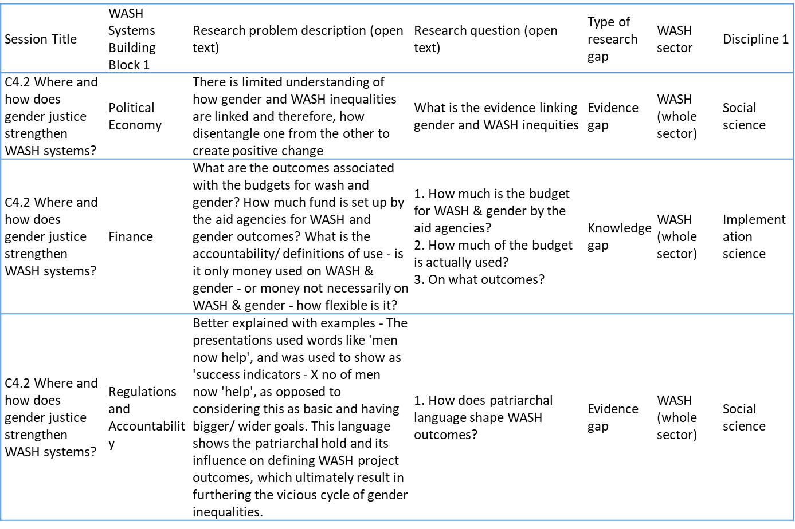
All systems connect symposium 2023
Trained research team attended 77 sessions at the All Systems Connect symposium in May 2023
Documented WASH system strengthening research gaps and categorised them by system strengthening block and research type
This led to the identification of 183 research gaps which was reduced to 153 after data cleaning.

Slide 36
UNC Water and Health 2023
Today’s group work (at the end of this presentation)
Ask you here today:
  What are the research and learning gaps in WASH Systems Strengthening?
  What platforms, tools, and methods have you used to engage stakeholders in learning?

Slide 37
Scoping Review on WASH Systems Strengthening
Search
Review
Extract
Conducted scoping review of peer-reviewed and grey literature
+150 peer-review articles on systems strengthening
+38 grey literature reports
Extract research questions from title, objectives and conclusions of articles and reports
De-duplicate and refine into a list of research questions
All published 2000 onwards
Mixture of English and other languages
Discuss WASH Systems Strengthening

Slide 38
Expert panel to prioritise research gaps using the Delphi Method
Round 1 – Expert panel survey ranking of research gaps
Expert-led survey ranking of research gaps on scale of 1-9 based on standard Delphi Methods.
Round 2 – Expert panel workshop
Expert panel discussion of results with emphasis on gaps with low consensus
Round 3 - Expert panel survey ranking of research gaps
Expert-led survey ranking of research gaps on scale of 1-9 based on standard Delphi Methods.
Emerging results
Top research gaps specified (overall, by building block and by sub sector) to inform the FCDO WASH Systems for Health research and knowledge strategy.
Answers analyzed to identify gaps with high and low consensus between respondents
Answers analyzed to identify relative rank of research gaps and levels of certainty (e.g. high and low consensus)

Slide 39
Interim results

Slide 40
Interim findings: research gaps by WASH sub-sector

Slide 41
Interim findings: research gaps by building blocks

Slide 42
Interim findings: research gaps by type of research
Research gap type category | % of responses
Knowledge Gaps: research to develop new types of, and approaches for, system strengthening approaches. | 35
Implementation Gaps: research to understand how practitioners should better implement system strengthening approaches. | 29
Evidence Gaps: research to assess whether a system strengthening approach or component of system strengthening is effective. | 18
Theoretical Gaps: research into understanding why and how system strengthening works or does not work. | 9
Methodology Gaps: research into approaches for studying, monitoring and evaluating system strengthening. | 9

Slide 43
Example Research gaps
“How can we adapt systems to better understand and act on climate change related loss and damage (e.g., harm/destructions)?”
“How can we strengthen systems for water quality monitoring in LMICs?”
“How can we monitor and evaluate system strengthening WASH programmes meeting the requirements for short-term accountability and long-term, indirect impact?”
“What are the opportunities and risks with applying AI [or extending its use] to support monitoring and decision-making in the WASH sector?”

Slide 44
Example gaps
“How can we adapt systems to better understand and act on climate change related loss and damage (e.g., harm/destructions)?”
“How can we balance risks from potential regulation of emissions so not to negatively influence the sanitation services for the poorest?”

Slide 45
Example Implementation gaps
“How can we strengthen systems for water quality monitoring in LMICs?”
“How can a systems approach be used to integrate gender, equity, and social inclusion in sanitation programmes?”
“If a WASH system in a fragile state is weak, should it be bypassed? How can weak WASH systems be adapted to fit an appropriate framework? How can parallel systems be combined for a long-term solution?”

Slide 46
Example Evidence gaps
“What are the predominant tools in use by different stakeholders in and outside the WASH sector to understand and strengthen systems?"
“What impacts the effectiveness of system strengthening tools in practice?”
“What impact does the cohesion (or lack thereof) between different tools make to overall sector performance?”

Slide 47
Example Theoretical gaps
“What role does corruption play in influencing the approaches to and outcomes from WASH system strengthening work?”
“Is 'system thinking' an extension of power imbalances and colonial history? Are we creating another way for 'experts' to retain control and, of so, what do we need to change, and how?”

Slide 48
Example Methodology gaps
“How can we monitor and evaluate system strengthening WASH programmes meeting the requirements for short-term accountability and long-term, indirect impact?”
“What are the opportunities and risks with applying AI [or extending its use] to support monitoring and decision-making in the WASH sector?”

Slide 49
Reflections and next steps
Combination of long-standing research gaps/tensions and new emerging issues
Context matters for system strengthening research and generalised questions are hard to construct and answer
We are still in the research gap harvesting stage – interested to hear your ideas
Further cleaning and, crucially, prioritisation will help us refine critical questions going forward

Slide 50
Questions?

Slide 51
Break-Out Groups
Tasks:
1. What research questions do you have within each building block? At a global, national and local level?
2. How do you capture successful systems change within each building block? At a global, national and local level?
Group 1: Vida
  Institutional Arrangements and Coordination
  Finance
  Regulations and Accountability
Group 2: Lisa
  Service Delivery and Infrastructure
  Water Resources Management
Group 3: Lauren
  Monitoring
  Planning
Notes:
* Frame as intersectoral

Slide 52
Example Research gaps
“How can we adapt systems to better understand and act on climate change related loss and damage (e.g., harm/destructions)?”
“How can we strengthen systems for water quality monitoring in LMICs?”
“How can we monitor and evaluate system strengthening WASH programmes meeting the requirements for short-term accountability and long-term, indirect impact?”
“What are the opportunities and risks with applying AI [or extending its use] to support monitoring and decision-making in the WASH sector?”

Slide 53
Example of specific gaps from one building block - finance
“How is debt impacting utilities balance sheets, in what ways does it influence utility behaviour, and what strategies can be used to support utilities to manage debt?”
“What capacity needs reside in banks and other financial institutions with regard to water financing needs?”

Slide 54
Audience discussion
Open question to the audience:
What learning platforms and delivery mechanisms would be useful to see when sharing research and learning on WASH systems strengthening?

Slide 55
Thank you
If you have any questions, please email:
Lisa Rudge, FCDO: lisa.rudge@fcdo.gov.uk
Lauren D’Mello-Guyett, LSHTM: lauren.dmello-guyett@lshtm.ac.uk
Paul Hutchings, University of Leeds: p.hutchings@leeds.ac.uk
Angela Huston, IRC: huston@ircwash.org

