Slide 1


Slide 2


KUMTUA MAMA NDOO KICHWANI!
Landing a bucket on a mother’s head

Slide 3

Tanzania national water policy, 2002
Sufficient supply of water and adequate means of sanitation are provided by the government of Tanzania
With special considerations for
provision of water supply services to vulnerable groups

Slide 4
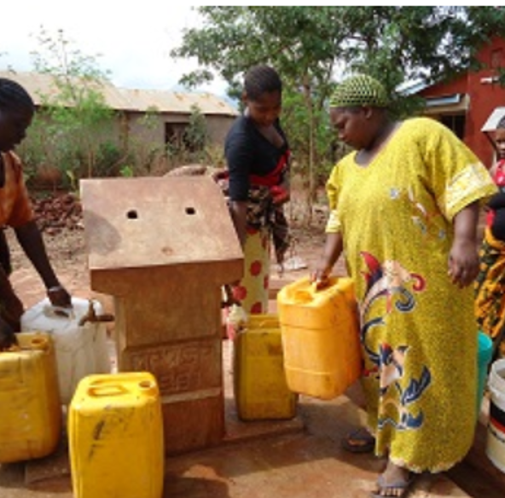
Provision of water services to the low-income households
Water kiosks and Domestics points
Water kiosks & domestic points is the approach used by most of water utilities in Tanzania to serve water to the low-income areas/households.
The challenges in the management, water accessibility, affordability and reliability has made us think of other approach which was Water in Premises

Slide 5
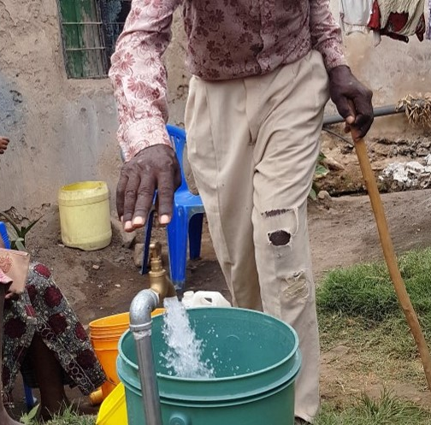
Water on-premise is regarded as safely managed water supply due to its reliability, accessibility and affordability

Slide 6
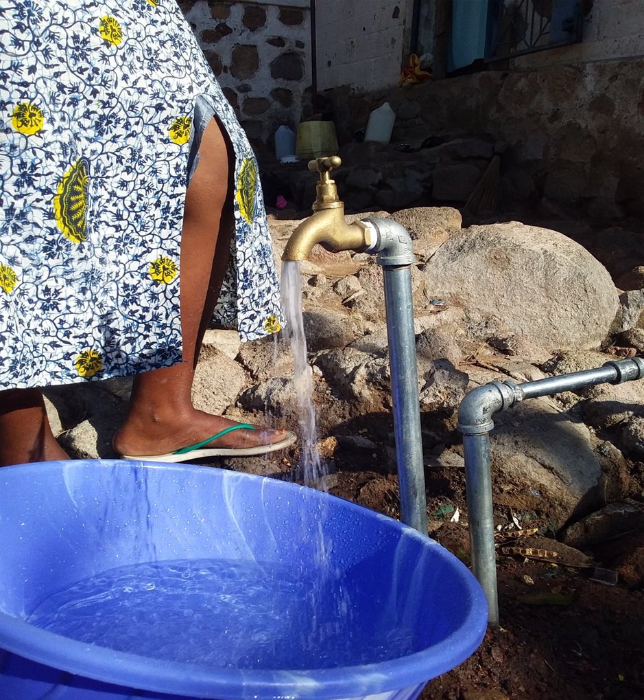
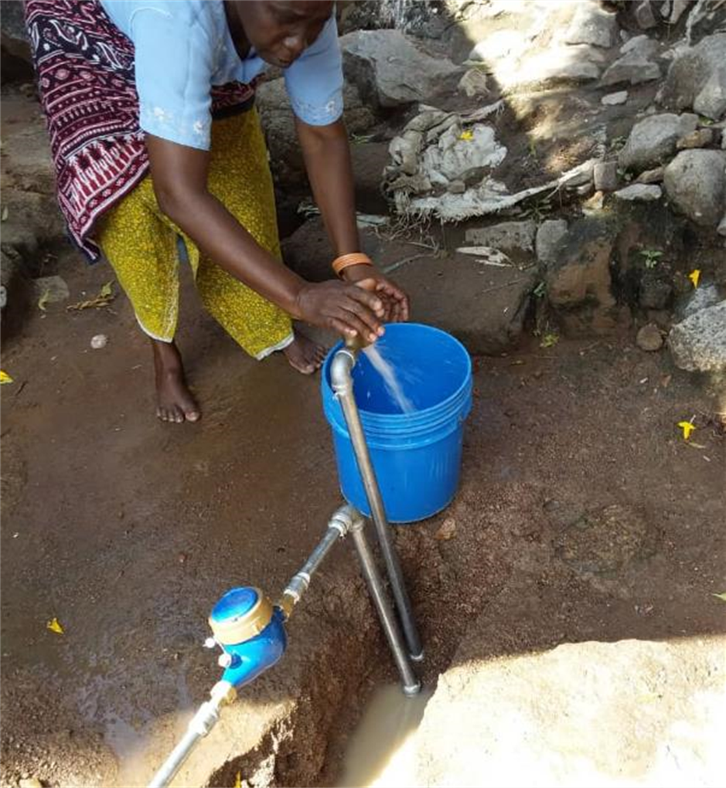
Water on-premise constrains
Initial costs for new water connections
Absence of distribution network

Slide 7
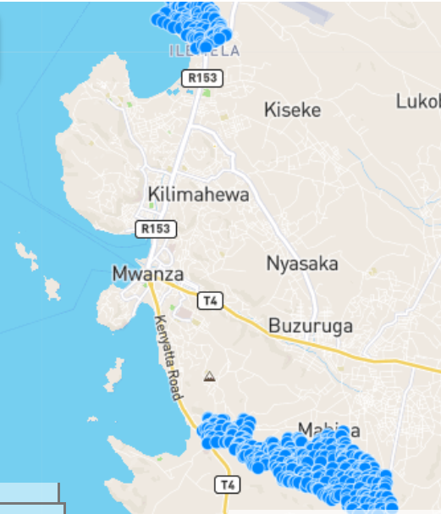
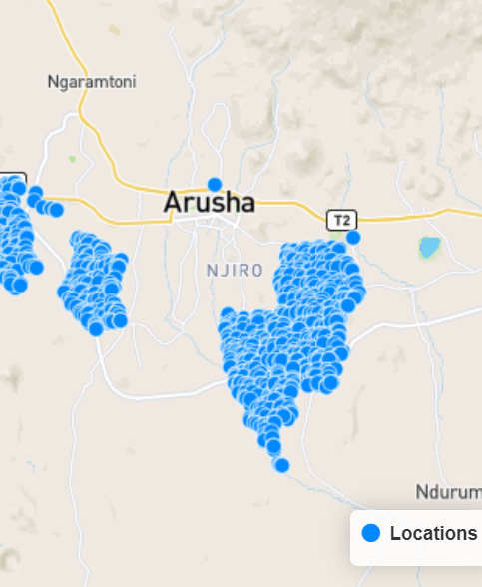
In Arusha & Mwanza, 56% of unconnected household cannot afford water Service connection payment
From House-to-House survey:
55% of the houses not connected
95% interested in having a water connection
56% of them, can’t afford the Service connection payment

Slide 8

But can low-income populations pay for water services ?

Slide 9
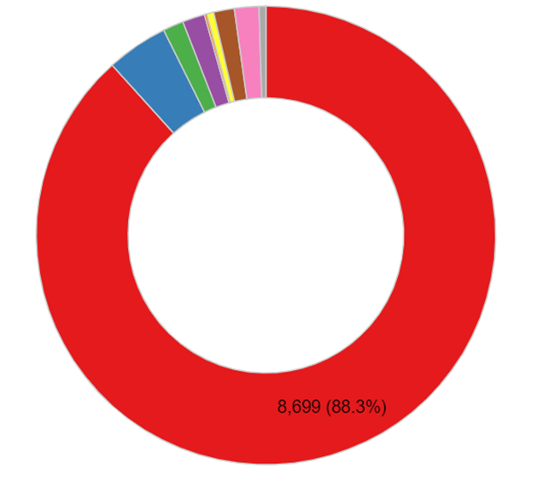
Where do you get water for your daily consumption?
From Households assessment survey 2018, 88.3 % of houses not connected to water services got water from their neighbours' taps
Costs of service connection for customer:
TSH 210,000 (€85,-)
Average consumption 5-15 m3/month, depending on size of the household
Save more then 50% on water expenses
8,699 (88.3%)
4 times more expensive per m³ compared to direct connections

Slide 10
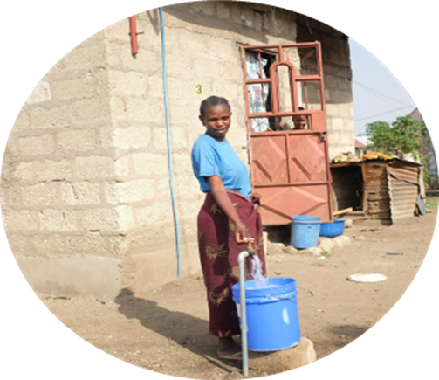
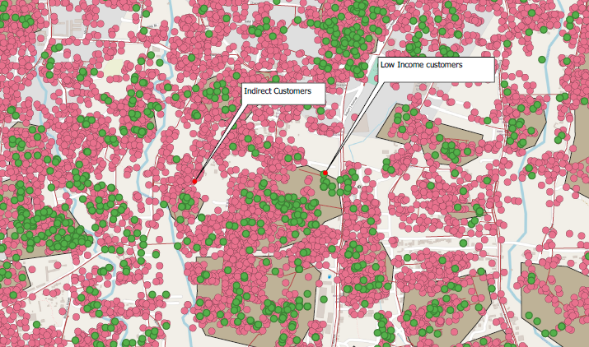
Provision of water services to the low-income households
Through Water for Life Fund, more than 6.
6000 households have been connected to water services directly and more than 24.000 indirectly
Indirect: customers who connected themselves to the distribution network
form the project

Slide 11
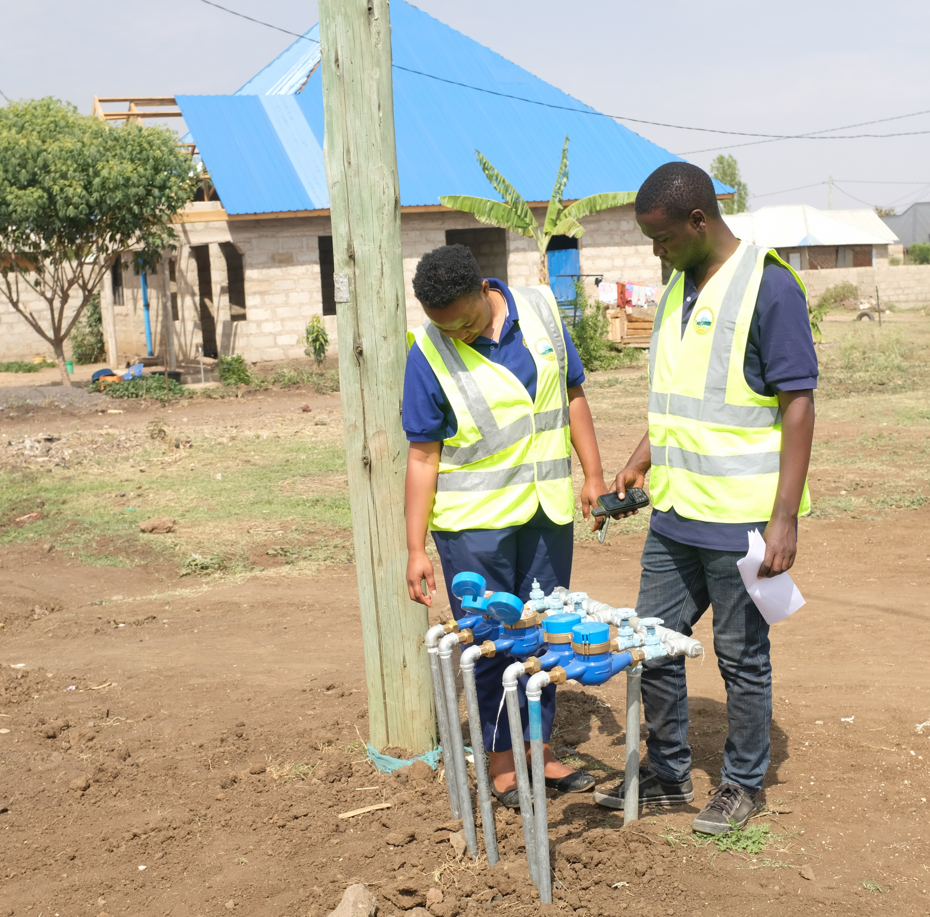
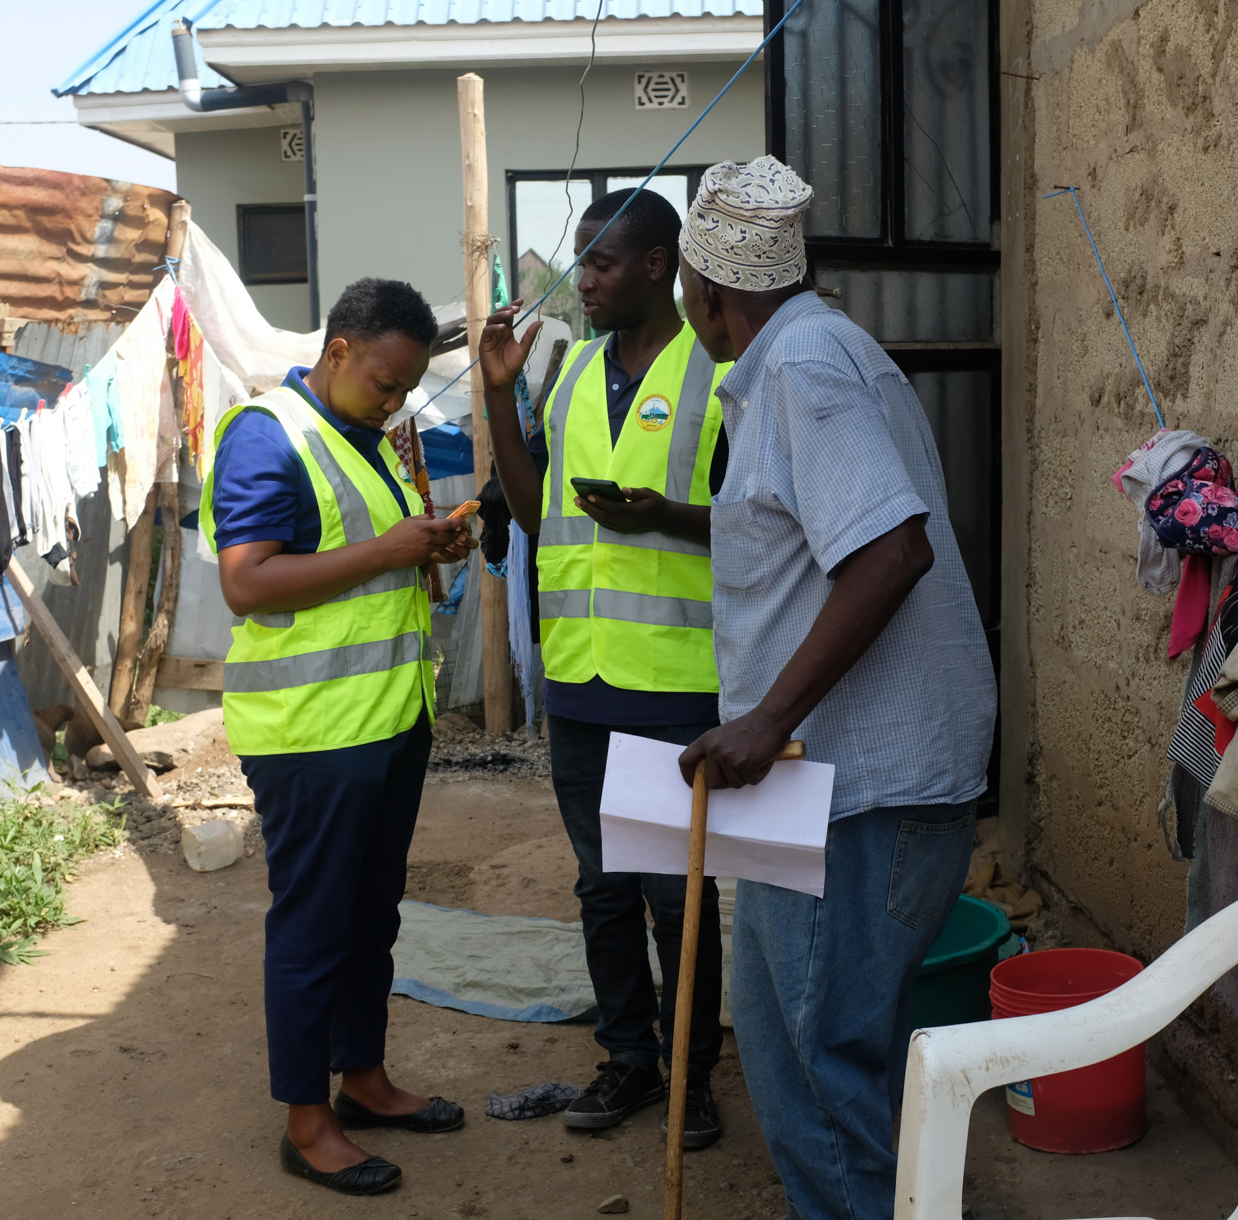
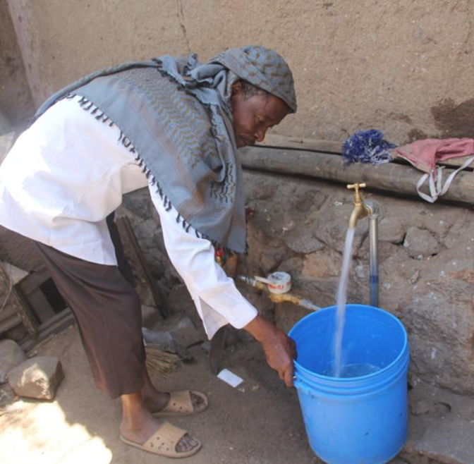
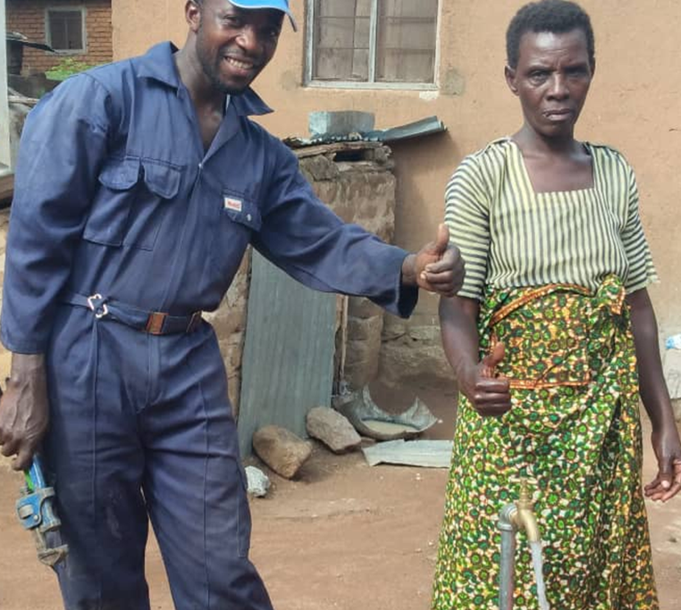
Water connection
Baseline survey to the beneficiaries
Exist situation to the selected beneficiaries

Slide 12
Return on investments
Payback time of the initial investment
For utility: 3-5 years For indirect customers: 10-11 months
Notes:
Revenues from LIA HH minus variable operational costs

Slide 13
Lessons learnt
Low-income customers can afford to pay for water bills
(low consumption, low water tariff)
House tap connection is easy to manage compared to the domestic
points /Kiosks
Through the new distribution network more people gain access to improved water sources
There is a return on investment for a utility when serving low-income customers, through increased water billings

