Slide 1

WATER INTEGRITY
GLOBAL OUTLOOK 2016
Clean water needs clean governance
Notes:
Add a fisrt explanatory

Slide 2
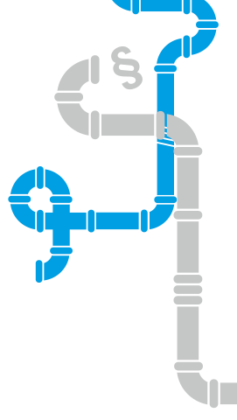
‘Water integrity is the integrity of people and institutions governing water resources. It refers to decision-making that is fair and inclusive, honest and transparent, accountable and free of corruption.’
Delft Statement, 2013
Notes:
‘Water integrity is the integrity of people and institutions governing water resources. It refers to decision-making that is fair and inclusive, honest and transparent, accountable and free of corruption.
The term recalls that management decisions have an ethical dimension, and that leadership requires courage, as well as technical skills’

Slide 3
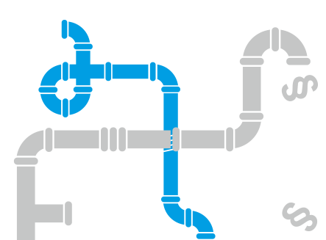
What is at stake ?
Estimated one third of humanity has no access to safe water and basic sanitation
85% increase in water consumption
predicted in just the global energy sector by 2035
100% increase of the global crop demand
from 2005 levels by 2050 for food and biofuel
The SDGs and the humans rights to water and sanitation need to be achieved
Notes:
Water integrity is a measure of the health of the sector.
Corruption undermines the global ability to provide food, water and energy security, to achieve the SDGs and to adapt to climate change.
Corruption most harms children, women, the poor and the powerless and can be seen as a crime against all of humanity.
Failures of governance are responsible for most water crises globally.
Water governance with greater integrity will achieve transparency, accountability and participation– and address corruption.

Slide 4

Notes:
The Water Integrity Global Outlook 2016 would not have been possible without the expertise and contributions of many individuals and institutions. WIN would like to thank our publication co-partners Cap-Net, GIZ, Global Water Partnership (GWP), UNDP Water Governance Facility at SIWI (WGF), Transparency International (TI), TI-Bangladesh (hosting BAWIN) for their continuous support and significant contributions, including editorial review.
Water Integrity Network would also like to express its gratitude to its donors – BMZ, DGIS, SDC and Sida – for their trust in WIN and for making WIGO possible.

Slide 5
WIGO is …
A demonstration that integrity becomes an international and national priority in water governance and management.

Slide 6
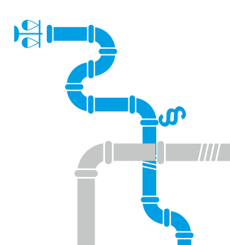

WIGO is …
A review of how institutional fragmentation and corruption undermine resources and services.

Slide 7
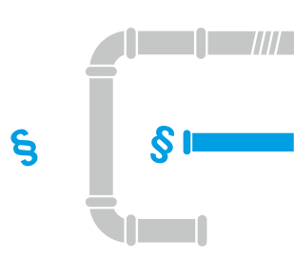
WIGO is …
An outline of approaches and tools that make improvements achievable.

Slide 8
WIGO is …
A set of recommendations for action by governments, sector actors, the private sector and civil society bodies.

Slide 9
KEY MESSAGES (1)
Weak financial data makes it difficult to track finances and losses.
shed
Notes:
Water integrity is a measure of the health of the sector.
Corruption undermines the global ability to provide food, water and energy security, to achieve the SDGs and to adapt to climate change.
Corruption most harms children, women, the poor and the powerless and can be seen as a crime against all of humanity.
Failures of governance are responsible for most water crises globally.
Water governance with greater integrity will achieve transparency, accountability and participation– and address corruption.

Slide 10
What is at stake ?
Every 10% of investment lost to corruption
means annual losses in excess of US$ 75 billion
Notes:
Water integrity is a measure of the health of the sector.
Corruption undermines the global ability to provide food, water and energy security, to achieve the SDGs and to adapt to climate change.
Corruption most harms children, women, the poor and the powerless and can be seen as a crime against all of humanity.
Failures of governance are responsible for most water crises globally.
Water governance with greater integrity will achieve transparency, accountability and participation– and address corruption.

Slide 11
What is at stake ?
Corruption in the sector undermines the global ability to provide food, water and energy security for all, to achieve the SDGs and to adapt to climate change.
Corruption is a disease that harms children, women, the poor and the powerless most.
Notes:
Water integrity is a measure of the health of the sector.
Corruption undermines the global ability to provide food, water and energy security, to achieve the SDGs and to adapt to climate change.
Corruption most harms children, women, the poor and the powerless and can be seen as a crime against all of humanity.
Failures of governance are responsible for most water crises globally.
Water governance with greater integrity will achieve transparency, accountability and participation– and address corruption.

Slide 12
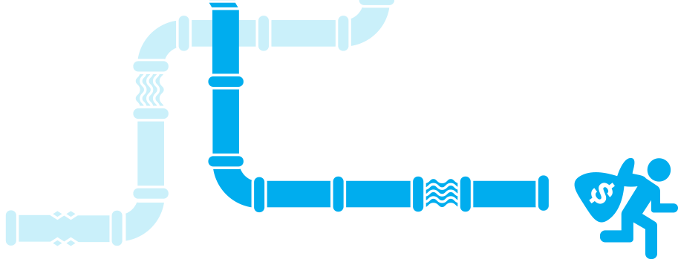
RECOMMENDATIONS
Strengthen water integrity in order to support the implementation of the SDGs and ensure the fulfilment of the human rights to water and sanitation.
Explicitly recognize and address the lack of integrity and the presence of corruption as major concerns in water governance and management.
Notes:
Develop and enforce water policies that incorporate TAP principles along with anticorruption measures in accordance with the obligations of the human rights to water and sanitation. The TAP framework is a powerful tool for states to fulfil their obligation to deliver these human rights. Strengthening enforcement mechanisms is important to ensure that water legislation and anti-corruption legislation effectively improve people’s living conditions, and requires cooperation between anti-corruption, judicial and water institutions.
Ensure public scrutiny and balance stakeholder interests in political and legislative processes. Water management experiences of the last decade suggest that mobilizing stakeholders is important to ensure that policy is developed and implemented so that it works for integrity and against corruption. The interests of all relevant actors must be taken into account fairly. The current rush for land and water to secure food and energy can lead to hasty policy-making. In this context, the voices of the poor and marginalized – who suffer most from the changes – must be taken into account. Water access in many regions depends on traditional institutions and power relations that do not connect to the state’s legal framework. Adopting, extending or linking customary laws to state laws, when applicable and fair, can help protect the rights of the marginalized and the vulnerable.

Slide 13
KEY MESSAGES (2)
Clearly defined, implemented and enforced laws and policies are needed to safeguard the integrity of the water sector.
Water policies should incorporate TAP principles in accordance with the obligations of the human rights to water and sanitation.
Multi-stakeholder participation in policy-making processes is key to ensuring that policy is implemented so that the most vulnerable do not lose out.

Slide 14
KEY MESSAGES (3)
Establishing integrity, trust and respect as ground rules at the outset of planning process sets a standard for preventing corruption and for a project or programme in achieving its aims.
All phases of a water project carry high integrity risks and require transparency, fairness, non-discrimination and accountability.
Involving citizens, consumers and civil society organizations is important for establishing integrity, especially in large-scale and complex processes. In particular women.

Slide 15
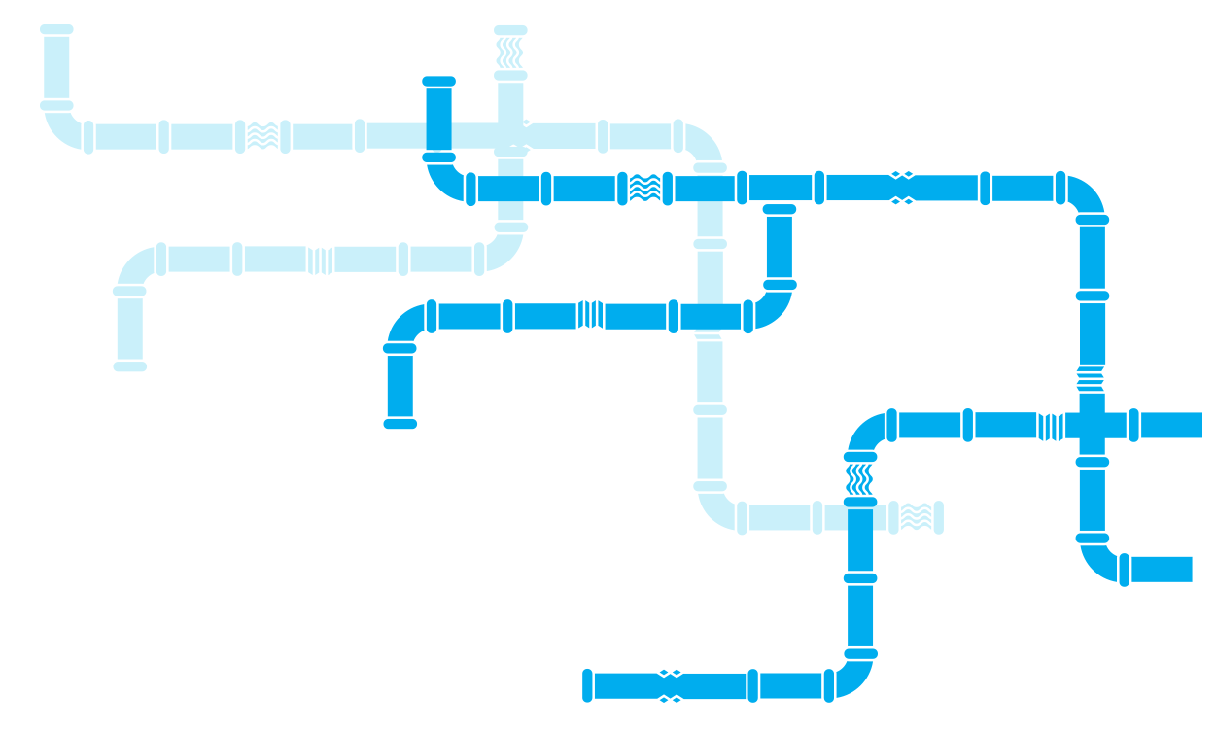
CASE STUDY: KENYA
Notes:
The Water Services Trust Fund (WSTF) in Kenya is a state corporation mandated to finance water and sanitation services for the poor and underserved communities. It receives funding from the Government and various donors. 6 The Fund has developed well-functioning risk management systems and produced outcomes that give good value for money (a 2014 survey of the condition of infrastructure found 84 per cent functionality). WSTF has established project selection procedures and a robust monitoring system. External audits are regularly carried out to verify the use of funds from the Fund down to the utility that implemented a project. However, so far the Fund has been an isolated sector initiative. Its integration into the country’s public finance system is limited.

Slide 16
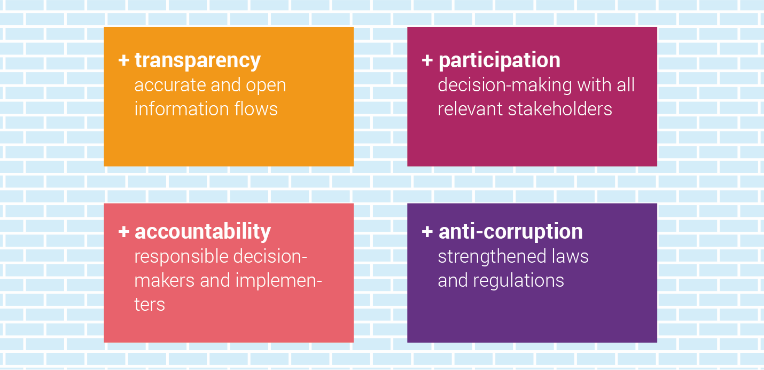
THE INTEGRITY WALL
Notes:
ALTERNATIVE SLIDE WITH THE WHOLE WALL (see next)
Put principles into practice: build ‘integrity walls’ appropriate to the context. It is no longer enough to enumerate the problems and weaknesses; it is time to build ‘integrity walls’ that keep out corruption and cement integrity as a core element of the water sector.
This Global Outlook constitutes a call to arms to policy-makers, governments, international agencies, institutions, citizens and the private sector to collaborate in order to build integrity in policies, investments, decisions, implementation and monitoring and evaluation.
Sector professionals, leaders and civil society groups can use this report as a trigger for active dialogue on the topic of water and corruption that will lead to changes in both policy and practice.

Slide 17
Integrity strategies and tools
Awareness raising
Policy
Regulation and oversight
Budgeting/procurement
Human resources
User feedback and social accountability
Notes:
Integrity strategies and tools for the water sector can tackle areas such as:
Policy
Regulation and oversight
Human resources
User feedback and social accountability
Budgeting/Procurement
Awareness raising
Integrity in the water sector requires a change in power relations to hold to account those who control knowledge, resources and decision-making. Advocacy, capacity development and a range of tools all have a role to play in strengthening transparency, accountability and participation.
Advocacy
Advocacy influences attitudes and behaviour and builds momentum for social or policy change in the water sector at local, national or international levels. It is used to convince sector decision-makers that change is needed and to educate the public to resist corruption. Guidelines for water integrity advocacy recommend:
Defining objectives with actionable indicators.
Targeting specific audiences with their own approaches
Conveying evidence-based and realistic messages
Building partnerships
Documenting impact, and publishing results
Right to information –protect whistleblowers
The right to information is crucial in preventing the misuse of power. More than 85 countries have a Freedom of Information Act and most have an ombudsman to investigate complaints. TI advocates for the legal protection for whistleblowers who reveal corrupt or unethical practices, and supports country level Advocacy and Legal Advice Centres (ALACs). The OECD has published a study of best practices and guiding principles for whistleblower protection.
Media can shine a light on corruption
Local and global media can highlight corruption and take integrity messages to the public. Media give a voice to social groups whose perspectives are not usually captured. Media effectiveness in exposing corruption requires independence (questions of ownership) freedom to operate (press freedom), capacity (good journalists) and the ability to reach people. Water sector specialists can provide journalists with information and facilitate visits to areas of concern.
Capacity development
‘Capacity is not only about skills and procedures; it is also about incentives and governance’ OECD
WIN promotes capacity development as a continuous process during which institutions, water groups and professional associations become better equipped to prevent corruption. It is important to strengthen institutions and organizations, not just the knowledge and skills of individuals.
One approach that has proved successful in sub-Saharan Africa, MENA and Latin America, is to bring water stakeholders from a region together to share experiences and assess integrity risks and capacity development needs.
Support from top levels of management is paramount to create a safe climate for training in which participants can share dilemmas, pressures and challenges. Staff must feel empowered and supported to challenge bad practice and to develop a zero-tolerance approach to corruption. Women are under-represented in capacity development initiatives. Training should include content on the gendered nature of water use and power disparities.
Tools to build integrity
Integrity tools can be used as an aid to prevent corruption and mismanagement to impose sanctions for breaches of integrity. Enforcement is mainly the task of specialized institutions, such as an anticorruption commission, public prosecutor or water sector regulator.
The Integrity Management Toolbox supports organizations to build integrity into strategic plans and business models, with a step-by-step methodology for change. The Toolbox was developed by the cewas, WIN and GIZ, with local partners in Kenya and support from BMZ.
Steps in an integrity risk management process can be seen here (link to a page with Figure 5.4 Steps of an integrity risk management process. Credit WIN, Hermann-Friede, Kropac, Achermann et al., 2014; GIZ, 2012.
A table describing strategies and tools that can be used in the water sector can be found here. (Link to page with Table 5.2)
Water jobs: an inclusive working climate, where roles and responsibilities are clear and working conditions are fair and satisfactory, is crucial to avoid unethical practices (this year’s topic of SWWW is Water Jobs!).

Slide 18
Integrity Risk Management

Slide 19
THE INTEGRITY WALL
Notes:
ALTERNATIVE SLIDE WITH THE WHOLE WALL (see next)
Put principles into practice: build ‘integrity walls’ appropriate to the context. It is no longer enough to enumerate the problems and weaknesses; it is time to build ‘integrity walls’ that keep out corruption and cement integrity as a core element of the water sector.
This Global Outlook constitutes a call to arms to policy-makers, governments, international agencies, institutions, citizens and the private sector to collaborate in order to build integrity in policies, investments, decisions, implementation and monitoring and evaluation.
Sector professionals, leaders and civil society groups can use this report as a trigger for active dialogue on the topic of water and corruption that will lead to changes in both policy and practice.

Slide 20
Thank you
Water Integrity Network Association e.V.
Alt-Moabit 91b, 10559 Berlin, Germany
info@win-s.org | www.waterintegritynetwork.net

